Slide 1

CDAC MUMBAI

Slide 2

BRIEF HISTORY
AVR basic architecture was conceived by two students at the Norwegian Institute of Technology (NTH) Alf-Egil Bogen and Vegard Wollan.
The acronym AVR has been reported to stand for Advanced Virtual RISC, but it has also been rumored to stand for the initials of the chip's designers: Alf and Vegard [RISC].
Atmel says that the name AVR is not an acronym and does not stand for anything in particular.

Slide 3
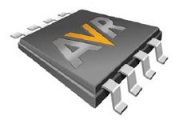
DEVICE OVERVIEW
Three Basic Families
TinyAvr
  1-8 kB program memory
  8-32-pin package
  Limited peripheral set
  Targets cost-sensitive applications in the very low end of the 8-bit MCU market
megaAVRs
  4-256 kB program memory
  28-100-pin package
  Extended instruction set ,Extensive peripheral set
  Targets medium-range applications where high throughput & low power is important
XmegaAVRs
  16-384kb program memory
  44-100 pin package
  Extended performance features such as DMA, Cache , Cryptography support etc
  Targets complex applications with requirements for large program memories
Application specific AVRs
  megaAVRs with special features such as LCD controller, USB controller, CAN controller etc

Slide 4
FEATURES IN ATMEGA128
Advanced RISC Architecture
133 Powerful Instructions – Most Single Clock Cycle Execution
32 x 8 General Purpose Working Registers + Peripheral Control Registers
Up to 16 MIPS Throughput at 16 MHz
On-chip 2-cycle Multiplier
Non-volatile Program and Data Memories
128K Bytes of In-System Reprogrammable Flash
  Endurance: 10,000 Write/Erase Cycles
4K Bytes EEPROM
  Endurance: 100,000 Write/Erase Cycles
4K Bytes Internal SRAM

Slide 5
PERIPHERAL FEATURES
53 programmable I/O lines
Two 8-bit Timer/Counters with Separate Prescalers and Compare Modes
Two 16-bit Timer/Counters with Separate Prescaler, Compare Mode and Capture Mode
Real Time Counter with Separate Oscillator
Two 8-bit PWM Channels
6 PWM Channels with programmable resolution from 2 to 16 bits
Output Compare Modulator
8-channel, 10-bit ADC
Byte-oriented Two-wire Serial Interface
Dual Programmable Serial USARTs
On-chip Analog Comparator
Master/Slave SPI Serial Interface

Slide 6
SPECIAL FEATURES
Programmable Watchdog Timer with on chip oscillator
Power on Reset and Programmable Brown out Detection.
Internal calibrated RC oscillator
External and Internal Interrupt Resources
Sleep Modes : Idle, ADC Noise reduction, Power save, Power down, Standby.
Software selectable clock frequency
4.5 to 5.5v operating voltage
64 lead TQFP

Slide 7
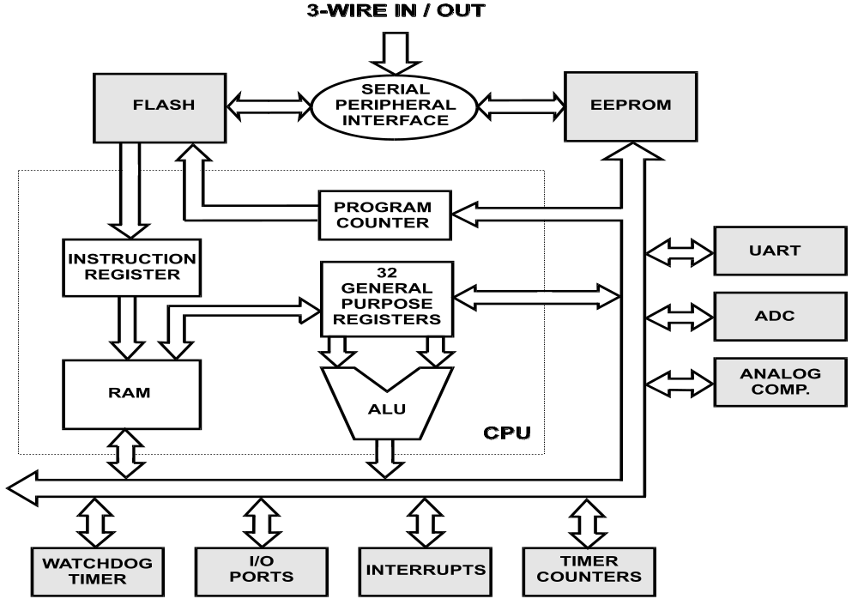
AVR FAMILY ARCHITECTURE

Slide 8
FLASH IN ATMEGA128
Since all AVR instructions are 16 or 32 bits wide, the Flash is organized as 64K x16.
For software security, the Flash Program memory space is divided into two sections, Boot Program section and Application Program section.
Constant tables can be allocated within the entire program memory address space (LPM instruction).

Slide 9
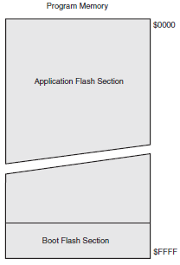
PROGRAM MEMORY MAP

Slide 10
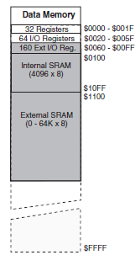
DATA MEMORY MAP

Slide 11
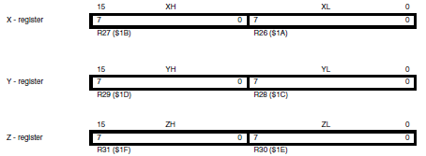
REGISTERS
Program Counter (PC) [16 bit ]
Status Register (SREG) [8 bit ]
Sack Pointer (SP) [16 bit ] [SPH, SPL]
General Purpose Register ( R0 – R31) [8 bit]
X , Y , Z Register [16 bit ]

Slide 12
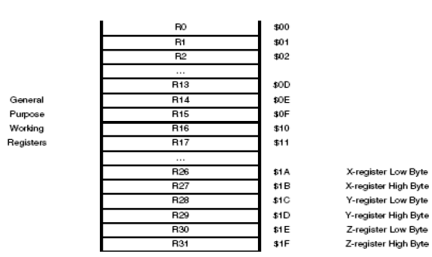
GENERAL PURPOSE REGISTER FILE

Slide 13
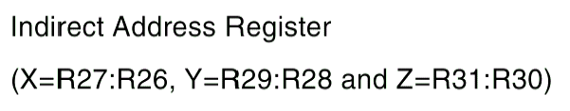
X, Y AND Z REGISTERS
The register r26 - r31 have some additional function to their general purpose usage.
These register are 16 bit address pointer for indirect addressing of the data space .

Slide 14
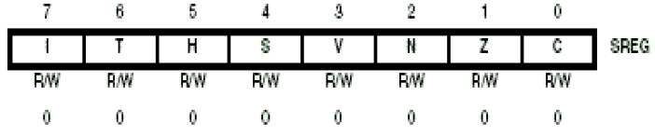
STATUS REGISTER
The micro controller operates based on the Status Register (SREG) and other internal registers. Most important is the Status Register which holds information on the last instruction and its result and Interrupt enable status.
The SREG holds 8 Flags:

Slide 15
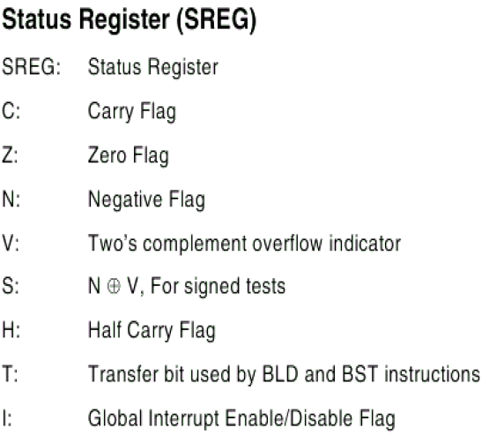

Slide 16
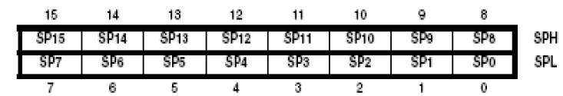
STACK POINTER
The Stack is mainly used for storing temporary data, for storing local variables and for storing return addresses after interrupts and subroutine calls.
The Stack Pointer Register always points to the top of the Stack.
The Stack is used by the ALU to store return addresses from subroutines.

Slide 17
ADDRESSING MODES
Register Addressing Mode
  Single Register
  Two Register
I/O Direct Addressing Mode
Data Direct Addressing Mode
Data Indirect Addressing Mode
  with displacement
  with pre – decrement
  with post – increment
Program Memory Addressing Mode

Slide 18
Direct Single Register Addressing
Register File
15
4
0
0
OP
Rd
d
31
Examples: COM Rd, SWAP Rd
INC Rd, DEC Rd, TST Rd, CLR Rd, SER Rd
LSL Rd, LSR Rd, ROL Rd, ROR Rd, ASR Rd

Slide 19
Direct Two Register Addressing
Register File
15
9
5
4
0
0
OP
Rr
Rd
d
r
31
Examples: ADD Rd,Rs SUB Rd,Rs AND Rd,Rs MOV Rd,Rs OR Rd,Rs

Slide 20
I/O Direct Addressing
I/O Memory
15
5
0
0
OP
Rr/Rd
A
63
Examples: IN Rd, PORT_ADDRESS
OUT PORT_ADDRESS, Rs

Slide 21
Direct Data Addressing
Data Memory
31
19
16
0X0000
OP
Rr/Rd
Data Address
15
0
0XFFFF
RAMEND
Examples: LDS Rd , K STS Rd,K
Where K is a16bit Address

Slide 22
Data Indirect Addressing
Data Memory
15
0
0X0000
X, Y or Z Registers
0XFFFF
Examples: LD Rd, X (X is pointer register R26:R27)
ST Rd, X

Slide 23
Data Indirect With Displacement
Data Memory
15
0
0X0000
Y or Z Register
+
OP
Rr/Rd
q
15
10
6
5
0
0XFFFF
RAMEND
Examples: LDD Rd, Y+q STD Y+q , Rr

Slide 24
Data Indirect With Pre-decrement or Post-increment
Data Memory
15
0
0X0000
X, Y or Z Register
+
-1 or +1
0XFFFF
RAMEND
Examples: LD Rd, +Y ST Z+, Rr
LD Rd, -Y ST Z-, Rr

Slide 25
Program Memory Constant Addressing
Program Memory
15
0
0X0000
Z Register
0XFFFF
Examples: IJMP and ICALL

Slide 26
Program Memory Addressing With
Post-Increment
Program Memory
15
0
0X0000
Z Register
+1
+
0XFFFF
Examples: LPM Z+ ELPM Z+

Slide 27
Direct Program Memory Addressing
Program Memory
31
16
0X0000
OP
6 MSB’S
16 LSB’S
15
0
Program Counter
21
0
0XFFFF
Examples: JMP & CALL

Slide 28
Indirect Program Memory Addressing
Program Memory
0X0000
Register Z
15
0
Program Counter
15
0
0XFFFF
Examples: LPM Rd,Z

Slide 29
Relative Program Memory Addressing
Program Memory
12
0X0000
OP
k
15
11
0
+
Program Counter
15
0
0XFFFF
Examples: RJMP & RCALL

Slide 30
INSTRUCTION SET GENERAL FEATURES
All Instructions (with a few exceptions) are 16 Bits Wide
Most Instructions are Executed in One Clock Cycle

Slide 31
INSTRUCTION SET CLASSIFICATION
Arithmetic/Logic Instructions
Data Transfer Instructions
Program Control Instructions
Bit Set/Test Instructions

Slide 32
ADD INSTRUCTIONS
“ADD” Add Two Registers
“ADC” Add Two Registers and Carry
“INC” Increment a Register
“ADIW” Add Immediate to Word *
* Works on the 4 Uppermost Register Pairs

Slide 33
SUBTRACT INSTRUCTIONS
“SUB” Subtract Two Registers
“SBC” Subtract with Carry Two Registers
“SUBI” Subtract Immediate from Register*
“SBCI” Subtract with Carry Immediate from Register*
“DEC” Decrement Register
“SBIW “ Subtract Immediate From Word**
* Works on Registers R16 - R31
** Works on the 4 Uppermost Register Pairs

Slide 34
EXECUTING “SUBI R16,K”
Instruction Word
Register File
Immediate Operand
Instruction
ALU

Slide 35
COMPARE INSTRUCTIONS
“CP” Compare Two Registers
”CPC” Compare with Carry Two Registers
“CPI” Compare Register and Immediate*
“CPSE” Compare Two Registers and Skip Next Instruction if Equal
* Works on Registers R16 - R31

Slide 36
LOGICAL INSTRUCTIONS
“AND” Logical AND Two Registers
“ANDI” Logical AND Immediate and Register *
“OR” Logical OR Two Registers
“ORI” Logical OR Immediate and Register *
“EOR” Logical XOR Two Registers
* Works on Registers R16 - R31

Slide 37
SHIFT/ROTATE INSTRUCTIONS
“LSL” Logical Shift Left
“LSR” Logical Shift Right
“ROL” Rotate Left Through Carry
“ROR” Rotate Right Through Carry
“ASR” Arithmetic Shift Right

Slide 38
SHIFT / ROTATE OPERATIONS
MSB
Register
LSB
Carry
LSR
0
ROR
ASR

Slide 39
DATA SRAM → REGISTER FILE
INSTRUCTIONS
“LD Rd,<PTR>” Load Indirect
“LD Rd,<PTR>+” Load Indirect with Post-Increment
“LD Rd,-<PTR>” Load Indirect with Pre-Decrement
“LDD Rd,<PTR>+q” Load Indirect with Displacement (0-63)*
“LDS Rd,<ADDR>“ Load Direct from SRAM (16-bit ADDR)**
* PTR =X, Y or Z
** Parts with SRAM > 64k bytes, memory page selected using the RAMPZ register

Slide 40
DATA SRAM ← REGISTER FILE
INSTRUCTIONS
“ST <PTR>,Rd” Store Indirect
“ST <PTR>+,Rd” Store Indirect with Post-Increment
“ST -<PTR>,Rd” Store Indirect with Pre-Decrement
“STD <PTR>+q,Rd” Store Indirect with Displacement (0-63) *
“STS <ADDR>,Rd” Store Direct from SRAM (16-bit ADDR)**
* PTR = X, Y or Z
** Parts with SRAM > 64k bytes, memory page selected using the RAMPZ register

Slide 41
MOVE 16 BYTES SRAM → REGISTER FILE
.def temp=r16 ;temporary storage register
.def cnt=r17 ;loop counter
ldi ZH,high(SRAM_LOCATION) ;init Z pointer
ldi ZL,low(SRAM_LOCATION)
clr YH ;init Y pointer
clr YL
ldi cnt,16 ;init loop counter
loop: ld temp,Z+ ;get data from SRAM
st Y+,temp ;store data in RF
dec cnt ;decrement counter
brne loop ;loop more if not done
ldi cnt,16 ;init loop counter
loop: ld temp,-Y ;get data from RF
st Z-,temp ;store data in SRAM
dec cnt ;decrement counter
brne loop ;loop more if not done

Slide 42
DATA TRANSFER REGISTER FILE ↔
SRAM STACK INSTRUCTIONS
“PUSH” PUSH a register on the stack
“POP” POP a register from the stack

Slide 43
DATA TRANSFER PROG. MEMORY
→ REGISTER FILE INSTRUCTIONS
“LDI” Load a Register with an Immediate Value (1 Cycle) *
“LPM” Transfer a byte from Program Memory @Z to R0 (2 Cycles)
* Works on R16 - R31,

Slide 44
THE LPM INSTRUCTION
MSB
Z Pointer
LSB
Selects Program Memory Address
Selects
Low/High Byte
The byte pointed to by Z is transferred to R0

Slide 45
REGISTER FILE ↔ I/O MEMORY TRANSFER INSTRUCTIONS
OUT Transfer a Byte from RF to I/O
IN Transfer a Byte from I/O to RF

Slide 46
PROGRAM CONTROL INSTRUCTION TYPES
Unconditional Jumps
Conditional Branches
Subroutine Call and Returns

Slide 47
UNCONDITIONAL JUMP INSTRUCTIONS
“RJMP” Relative Jump *
“JMP” Absolute Jump **
“IJMP” Indirect Jump to Program Location@Z
* - Reaches ± 2K instructions from current program location.
- Wrap-around
** 4-Byte Instruction

Slide 48
CONDITIONAL BRANCH INSTRUCTIONS (FLAG SET)
“BREQ” Branch if Equal
“BRSH” Branch if Same or Higher
“BRGE” Branch if Greater or Equal (Signed)
“BRHS” Branch if Half Carry Set
“BRCS” Branch if Carry Set
“BRMI” Branch if Minus
“BRVS” Branch if Overflow Flag Set
“BRTS” Branch if T Flag Set
“BRIE” Branch if Interrupt Enabled

Slide 49
CONDITIONAL BRANCH INSTRUCTIONS (FLAG CLEAR)
“BRNE” Branch if Not Equal
“BRLO” Branch if Lower
“BRLT” Branch if Less Than (Signed)
“BRHC” Branch if Half Carry Clear
“BRCC” Branch if Carry Clear
“BRPL” Branch if Plus
“BRVC” Branch if Overflow Flag Clear
“BRTC” Branch if T Flag Clear
“BRID” Branch if Interrupt Disabled

Slide 50
SUBROUTINE CALL AND RETURN INSTRUCTIONS
“RCALL” Relative Subroutine Call *
“CALL” Absolute Subroutine Call **
“ICALL” Indirect Subroutine Call to Routine @Z
“RET” Return from Subroutine
“RETI” Return from Interrupt Routine
* - Reaches ± 2K instructions from current program location
- Wrap-around
** 4-Byte Instruction

Slide 51
BIT SET AND BIT TEST INSTRUCTIONS
“SBR” Set Bit(s) in Register *
“SBI” Set Bit in I/O Register **
“SBRS” Skip if Bit in Register Set
“SBIS” Skip if Bit in I/O Register Set **
* Works on Registers R16 - R31
** Works on I/O Addresses $00 - $1F

Slide 52
BIT CLEAR AND BIT TEST INSTRUCTIONS
“CBR” Clear Bit(s) in Register *
“CBI” Clear Bit in I/O Register **
“SBRC” Skip if Bit in Register Clear
“SBIC” Skip if Bit in I/O Register Clear **
* Works on Registers R16 - R31
** Works on I/O Addresses $00 - $1F

Slide 53
ASSEMBLY
What’s Right With Assembly Language?
• Speed. ALP’s are generally the fastest programs around.
• Space. ALP’s are often the smallest.
• Knowledge. Your knowledge of assembly language will help
you write better programs, even when using HLLs.
What’s Wrong With Assembly Language?
• Assembly is hard to learn & write.
• Assembly language programming is time consuming.
• Improved compiler technology has eliminated the need for
assembly language.
• Assembly language is not portable.

Slide 54
AVR -LAB
avr-as -D –gstabs -ahlms -mmcu=atmega128 -o file.o file.s
avr-ld –A atmega128 -o file file.o
simulavr -d atmega128 -g &
avr-gdb file

Slide 55
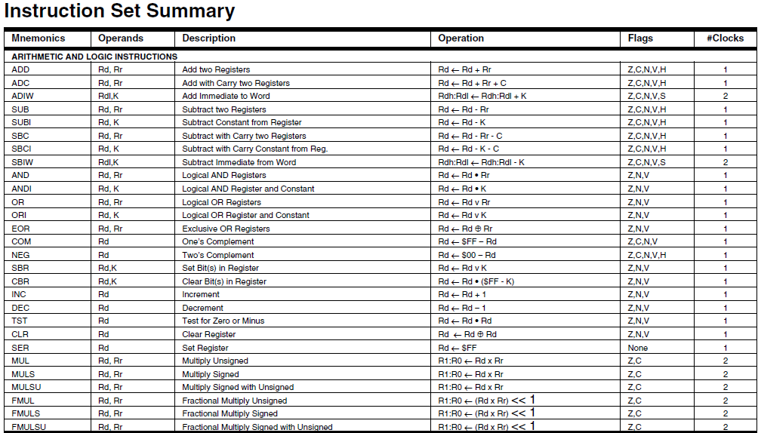
AVR INSTRUCTION SET

Slide 56
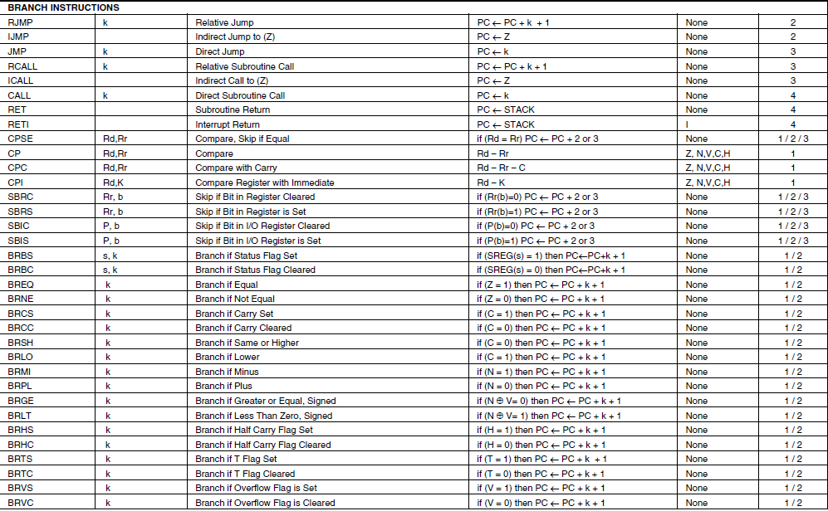

Slide 57
